Slide 1
Quantum
Wasserstein Generative
Adversarial Networks
An overview and implementation
Santiago Acevedo - Angel Martínez - November 2023

Slide 2
Content
Wasserstein Generative Adversarial Networks
Generative Adversarial Networks
Implementation and Planets Images Generation Example
Wasserstein Generative Adversarial Networks
Implementation using WGANs-GP
Quantum Machine Learning
Quantum Data Encoding, Quantum Gradients and VarQITE
Generative Quantum Machine Learning
Quantum Generative Adversarial Networks
References

Slide 3
Content
Quantum Wasserstein Generative Adversarial Networks
Generative Adversarial Networks
Planets Images Generation Example
Wasserstein Generative Adversarial Networks
WGANs vs. DCGANs
Quantum Computing
Quantum Machine Learning
Quantum Generative Adversarial Networks
Quantum Finance Example
References

Slide 4
Generative Adversarial Networks

Slide 5
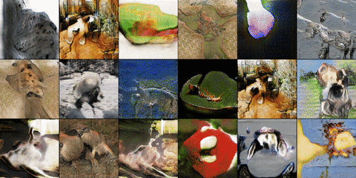
GANs
01
Introduction
Framework for estimating generative models via adversarial process:
A generative model $G$ generates samples that captures the data distribution
A discriminative model $D$ estimates the probability that a sample came from the training data rather than $G$

Slide 6
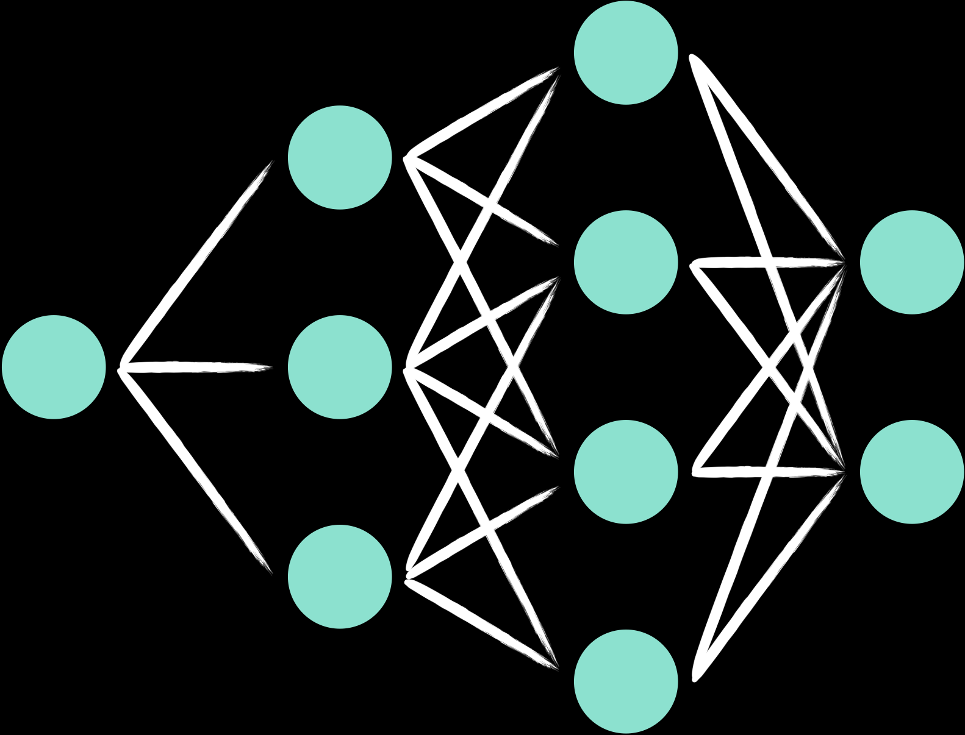
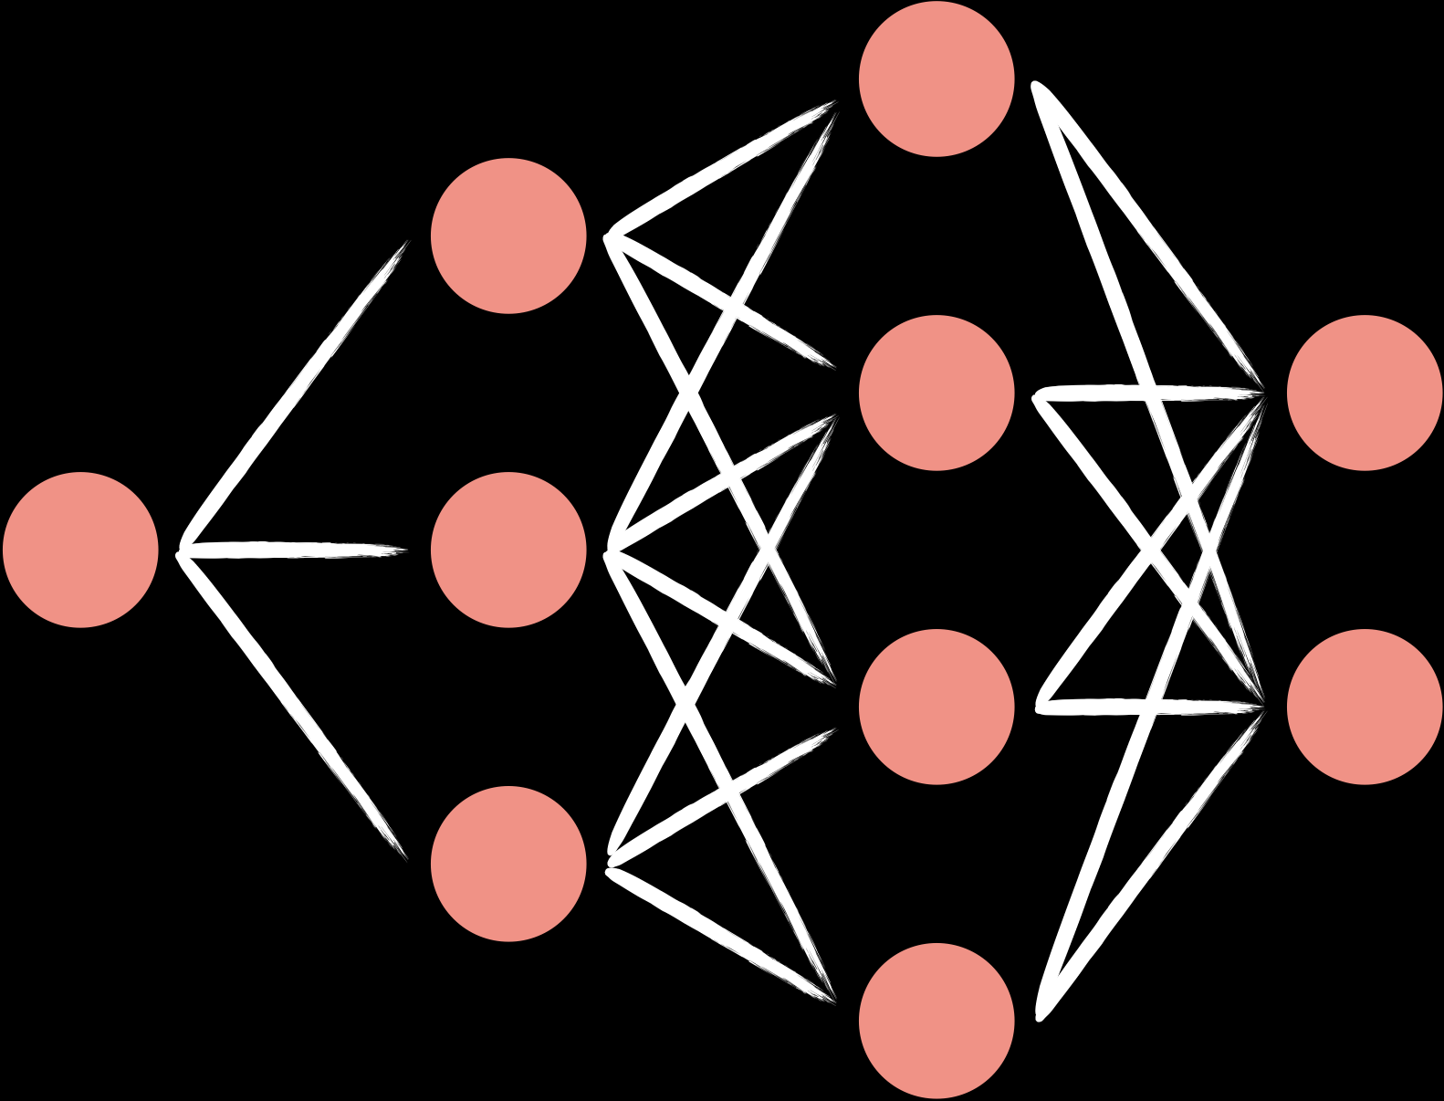
GANs
02
Generative Adversarial Networks (2014)
The adversarial modeling framework is most straightforward to apply when the models are both multilayer perceptrons
Generator $G(z,θ_{g})$
$$\overset{⏞}{}$$
$D(x,θ_{d})$ Discriminator
The training procedure for $G$ is to maximize the probability of $D$ making a mistake

Slide 7
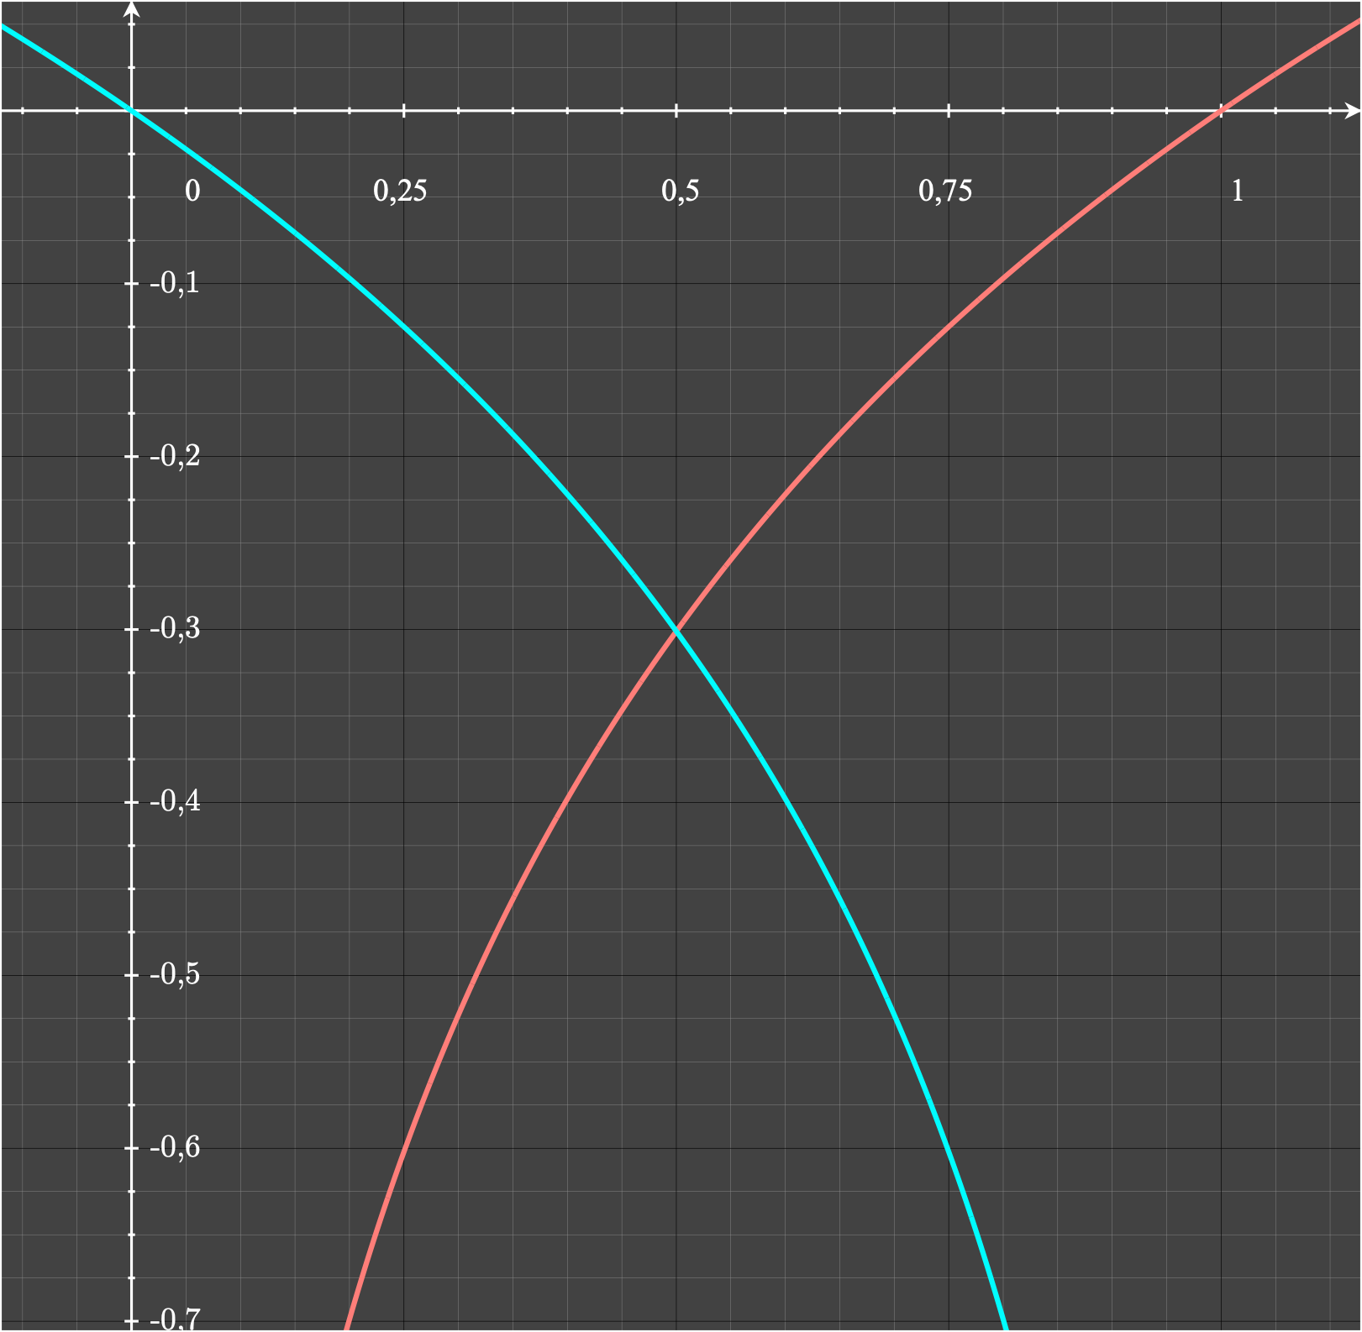
GANs
03
Algorithm
for numbers of training iterations do
for k steps do
> Sample $\{z^{(1)},…,z^{(m)}\}∼p_{g}(z)$
> Sample $\{x^{(1)},…,x^{(m)}\}∼p_{data}(x)$
> Update the discriminator by ascending stochastic gradient
$$∇_{θ_{d}}\frac{1}{m}\overset{m}{\underset{i=1}{∑}}\left[logD(x^{(i)})+log(1-D(G(z^{(i)})))\right]$$
end for
> Sample $\{z^{(1)},…,z^{(m)}\}∼p_{g}(z)$
> Update the generator by descending stochastic gradient
$$∇_{θ_{d}}\frac{1}{m}\overset{m}{\underset{i=1}{∑}}log(1-D(G(z^{(i)})))$$
end for
$$D(x^{(i)})$$
$$D(G(z^{(i)}))$$
$$G(z^{(i)})$$
We alternate $k$ steps optimizing $D$ and
one step optimizing $G$
This results in $D$ maintaining near its optimal solution, as $G$ changes slowly enough
$$D(G(z^{(i)}))$$
$$G(z^{(i)})$$

Slide 8
Lets see an implementation in astrophysics context

Slide 9


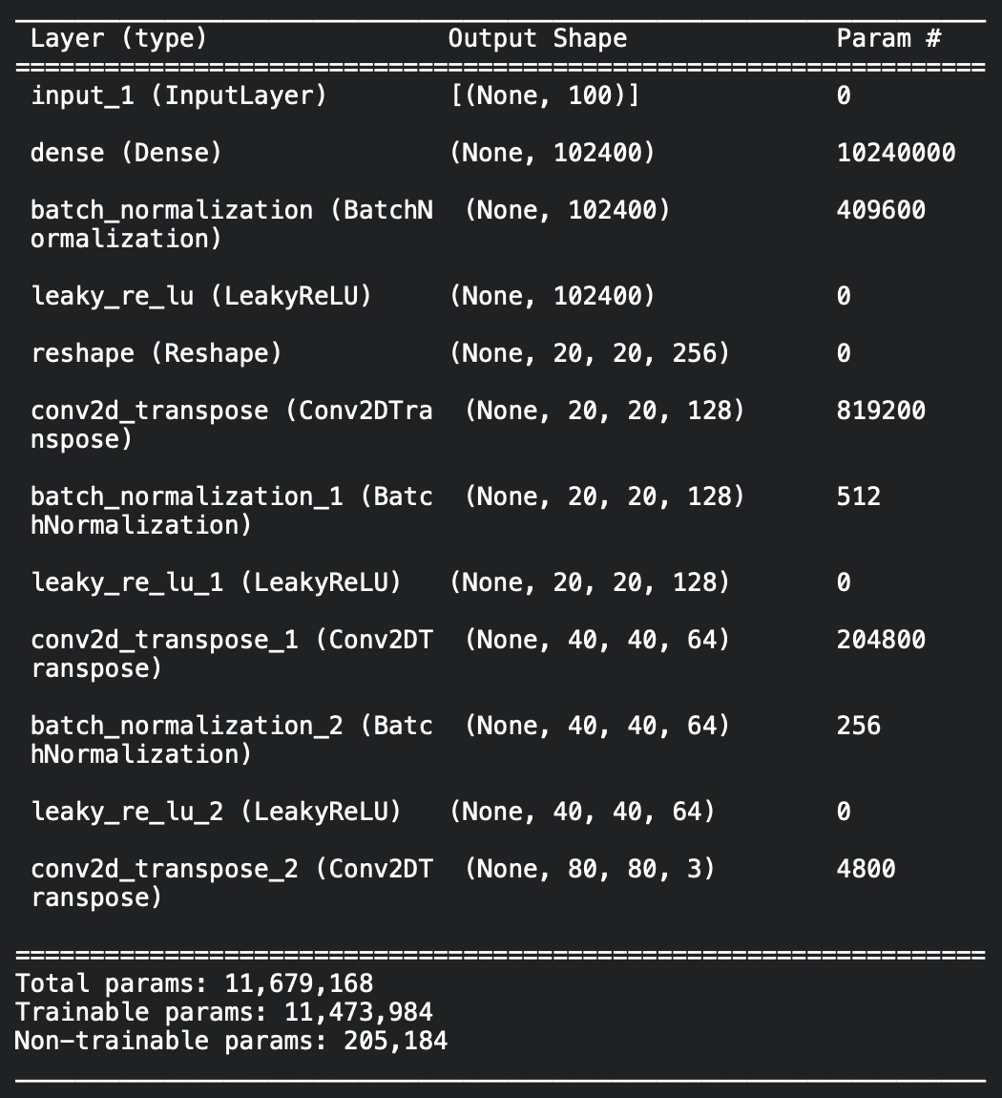
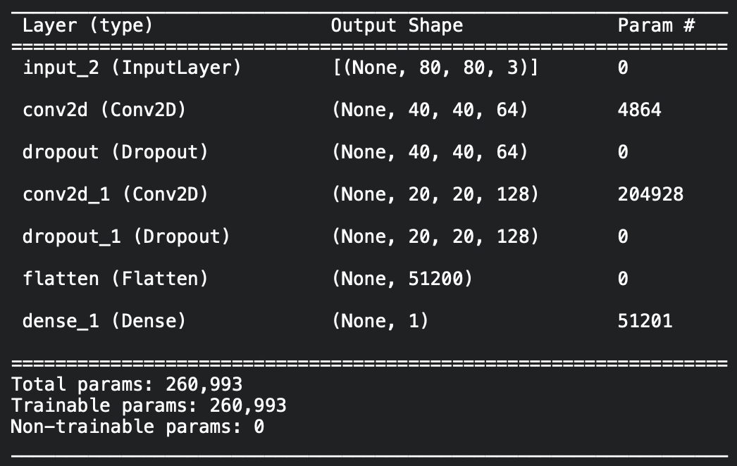
GANs
04
Planets Images Generation Specifications
Generator Architecture
Dataset size: 1834 Images of 9 planets
Images size: 80px X 80 px X 3 Channels
Training time: 25 minutes approx.
Optimizer: Adam
Epochs: 10000
Discriminator Architecture

Slide 10
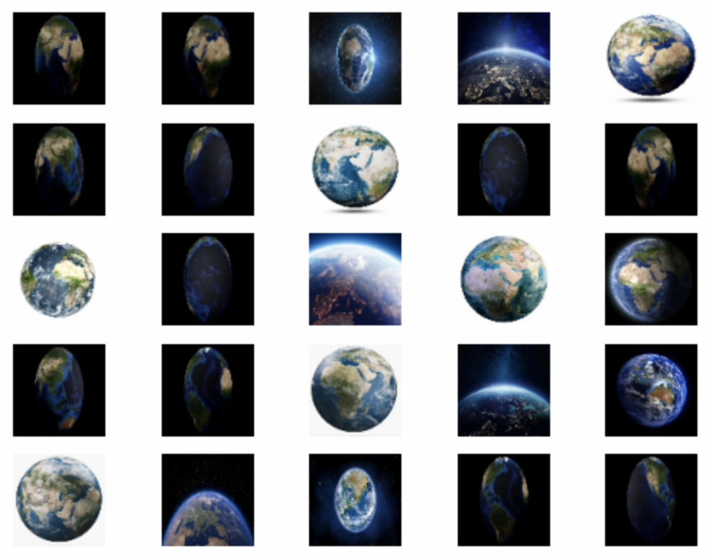
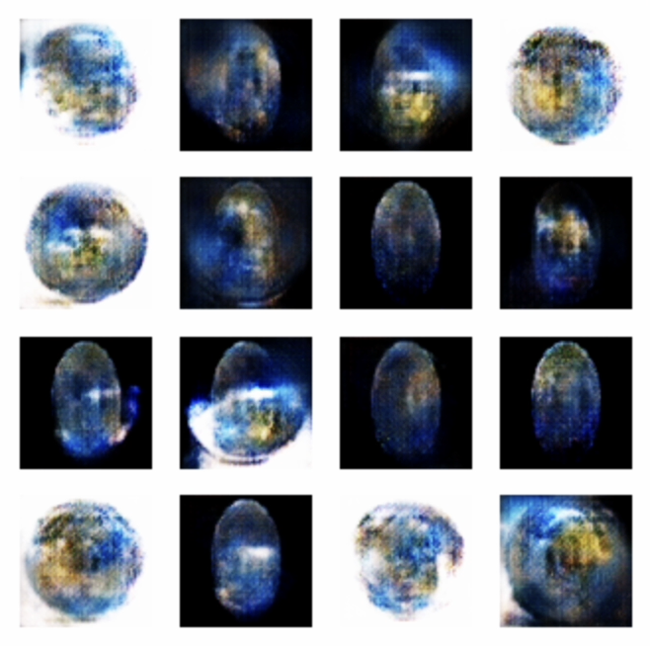
GANs
05
Planets Images Generation Results
219 images of the Earth
Epoch 10000
Original Images
Generated Images

Slide 11
GANs
06
Difficulties
GANs architecture possess an immense potential but fail trying to perform some difficult computations
Two of the most common reasons are:
$$\overset{⏞}{}$$
Convergence failure
Mode Collapse
The model failed to produce optimal or good quality results
The model failed to produce unique images repeating a similar pattern or quality

Slide 12
Wasserstein Generative Adversarial Networks

Slide 13
WGANs
Probability Distributions Distance
The objective of the Generative Adversarial Networks is to ensure that $P_{g}(z)$ and $P_{r}(x)$
probability distributions are close to each other so that the output generated is highly realistic and high-quality
$$P_{m}=\frac{P_{r}+P_{g}}{2}$$
How can we calculate the distance between two probability distributions?
Total Variation (TV) distance
$$δ(P_{r},P_{g})=\sup_{A∈Σ}|P_{r}(A)-P_{g}(A)|$$
Jensen-Shannon (JS) divergence
$$JS(P_{r},P_{g})=KL(P_{r}∥P_{m})+KL(P_{g}∥P_{m})$$
Kullback-Leibler (KL) divergence
$$KL(P_{r}∥P_{g})=∫log\left(\frac{P_{r}(x)}{P_{g}(x)}\right)P_{r}(x)dμ(x)$$
Earth-Mover (EM) distance or Wasserstein-1
$$W(P_{r},P_{g})=\inf_{γ∈Π(P_{r},P_{g})}E_{(x,y)∼γ}[∥x-y∥]$$

Slide 14
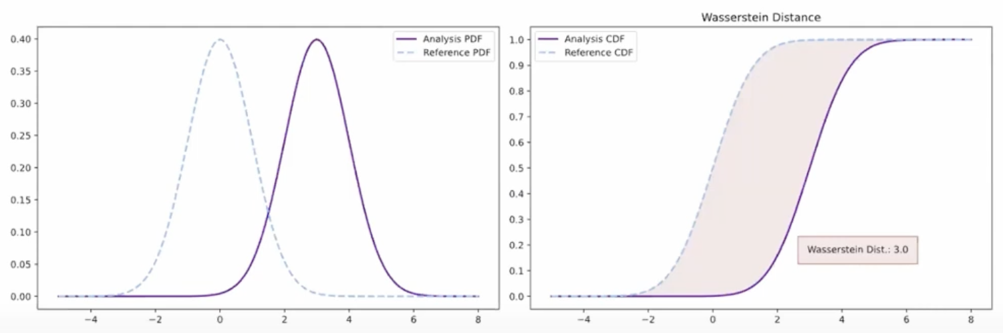
WGANs
07
Probability Distributions Distance
The objective of the Generative Adversarial Networks is to ensure that $P_{g}(z)$ and $P_{r}(x)$
probability distributions are close to each other so that the output generated is highly realistic and high-quality
How can we calculate the distance between two probability distributions?
The Wasserstein distance

Slide 15
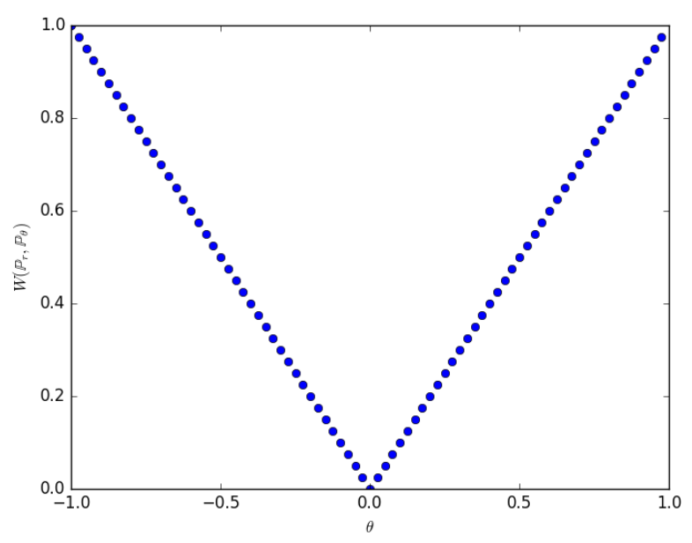
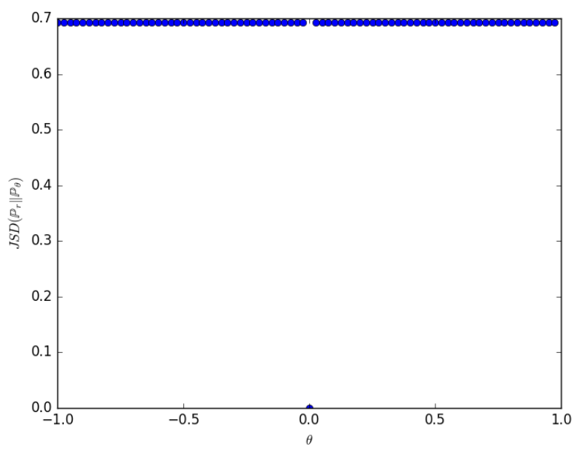
WGANs
Wasserstein Distance
There are some probability distributions that converge under the Wasserstein distance but do not under the other distances and divergences
$$W(P_{r},P_{g})$$
In those cases we can apply gradient descent on the Wasserstein distance (due to its continuity) in order to learn a probability distributions
$$JS(P_{r},P_{g})$$
However the Wasserstein distance is much weaker than the JS distance
Due to the Theorem 1 and the Corollary 1,
The use of a Feedforward Neural Network implies minimizing the Wasserstein distance make sense (continuous and differentiable)
Due to the Theorem 2,
The Wasserstein distance is a more sensible cost function for this problem than the KL, JS and TV distances.

Slide 16
WGANs
Wasserstein Gradient
The Wasserstein distance have nice properties when optimized, but the infimum is highly intractable
On the other hand, the Kantorovich-Rubinstein duality tell us:
$$W(P_{r},P_{θ})=\sup_{∥f∥_{L}≤1}E_{x∼P_{r}}[f(x)]-E_{x∼P_{θ}}[f(x)]$$
Overall the 1-Lipschitz functions $f:X→ℜ$
$$\overset{⏞}{}$$
$$\overset{⏞}{}$$
Due to the Theorem 3 we can differentiate $W(P_{r},P_{θ})$:
$$∇_{θ}W(P_{r},P_{θ})=-E_{z∼p(z)}[∇_{θ}f(g_{θ}(z))]$$
In order to have the parameters $w$ of the neural network $f_{w}$ lie in a compact space,
We can clamp the weights to a fixed box after each gradient update. (Lipschitz Constraints)

Slide 17
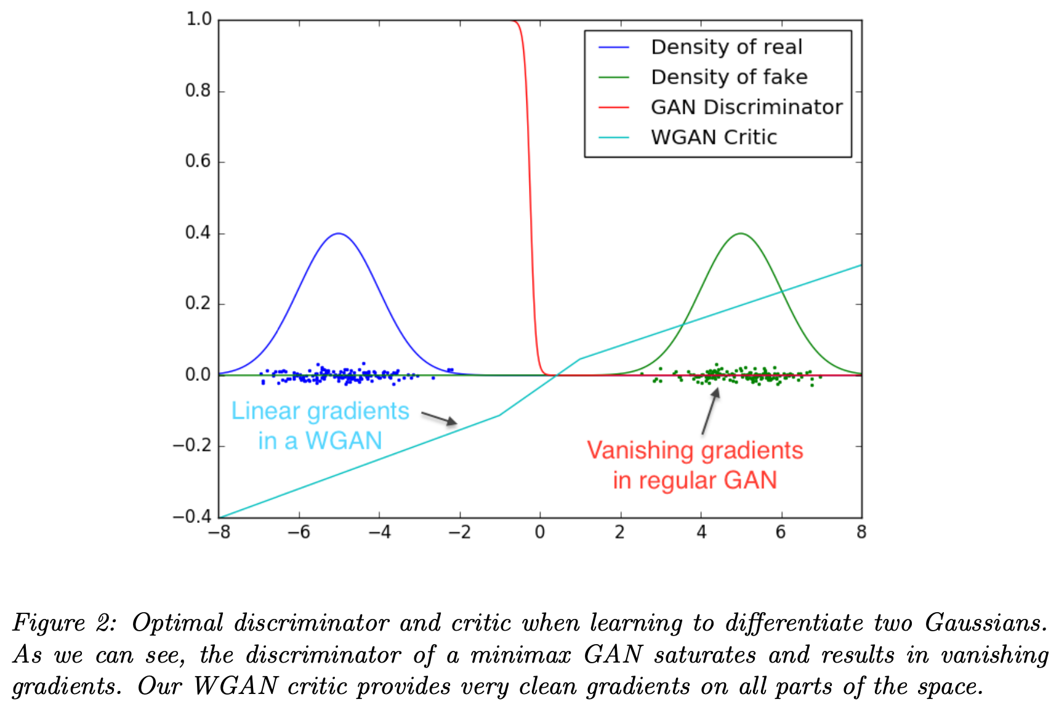
WGANs
WGANs Efficience
The Generator network in a WGANs is the function $g_{θ}$,
While the Critic (discriminator) network corresponds to $f_{w}$
Wasserstein GANs can be used for combating GANs difficulties
WGAN offers higher stability to the training model in comparison to simple GAN architectures
Meaningful learning curves useful for debugging and hyperparameters searches
No evidence of
mode collapse in
the experiments

Slide 18
WGANs
08
WGANs Efficience
The Generator network in a WGANs is the function $g_{θ}$,
While the Critic (discriminator) network corresponds to $f_{w}$
We can apply gradient descent on the Wasserstein distance (due to its continuity) in order to learn a probability distributions
WGAN offers higher stability to the training model in comparison to simple GAN architectures
Meaningful learning curves useful for debugging and hyperparameters searches
No evidence of
mode collapse in
the experiments

Slide 19
WGANs
while $θ$ has not converged do
for $t=0,…,n_{critic}$ do
> Sample real data $\{x^{(1)},…,x^{(m)}\}∼p_{r}(x)$
> Sample prior data $\{z^{(1)},…,z^{(m)}\}∼p_{g}(z)$
> Update the critic by ascending stochastic gradient
$$f_{w}←∇_{w}\frac{1}{m}\overset{m}{\underset{i=1}{∑}}\left[f_{w}(x^{(i)})-f_{w}(g_{θ}(z^{(i)}))\right]$$
$$w←w+α⋅\text{RMSProp}(w,f_{w})$$
$$w←\text{clip}(w,-c,c)$$
end for
> Sample prior data $\{z^{(1)},…,z^{(m)}\}∼p_{g}(z)$
> Update the generator by descending stochastic gradient
$$g_{θ}←-∇_{θ}\frac{1}{m}\overset{m}{\underset{i=1}{∑}}f_{w}(g_{θ}(z^{(i)}))$$
$$θ←θ-α⋅\text{RMSProp}(θ,g_{θ})$$
end while
Algorithm
Default values used in the paper:
$α=0.00005$ is the learning rate
$c=0.01$ is the clipping parameter
$n_{critic}=5$ is the number of iterations
per generation iteration
$m=64$ is the batch size
$$f_{w}$$
$$f_{w}$$
$$f_{w}$$
$$g_{θ}$$
$$f_{w}$$
It also requires:
The initial critic parameters $w_{0}$
The inicial generator’s parameters $θ_{0}$
$$g_{θ}$$
$$f_{w}$$
$$g_{θ}$$
$$g_{θ}$$

Slide 20
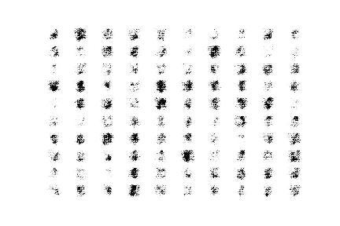
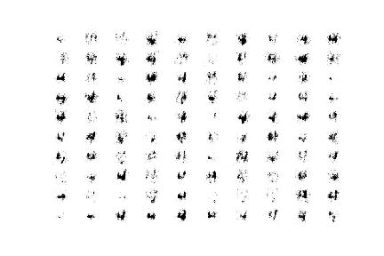
WGANs
Epoch 100
Results and Examples
MNIST
Generator and Critic loss functions
Epoch 1500
MNIST (Only 4)
Epoch 3500

Slide 21
WGANs
WGANs Difficulties and WGAN-GP
One of the main disadvantages of WGANs is that weight clipping
was found to do not always work as optimally as expected.
When the weight clipping was sufficiently large, it led to longer training times as the critic took a lot of time to adjust to the expected weights.
When the weight clipping was small,
it led to vanishing gradients, especially in cases of a large number of layers, no batch normalization, or problems related to RNNs.
One of the best methods introduced to combat these issues was the use of the gradient penalty method.
Adding a loss term that keeps the L2 norm of the discriminator gradients close to 1.

Slide 22
WGANs
09
Comparison between GAN and WGAN

Slide 23
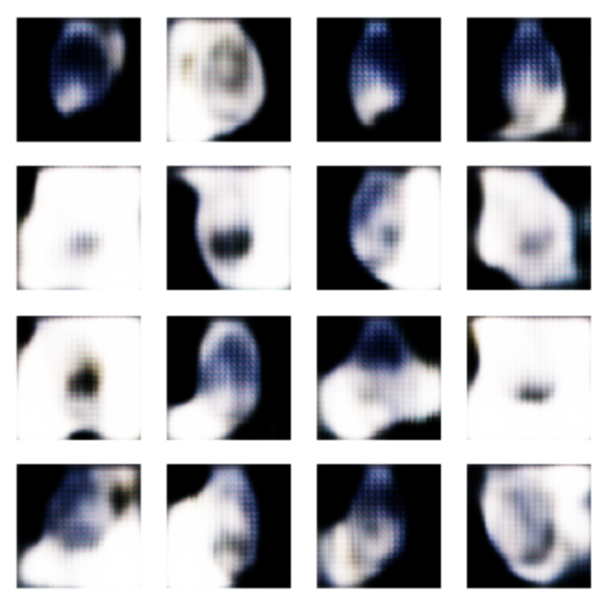
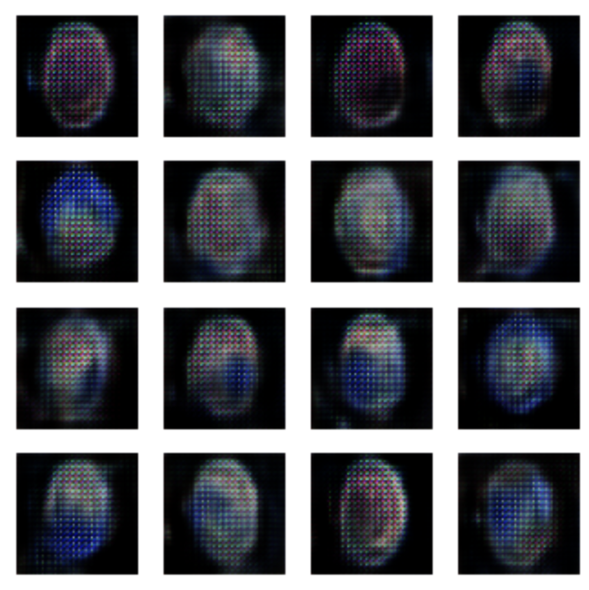
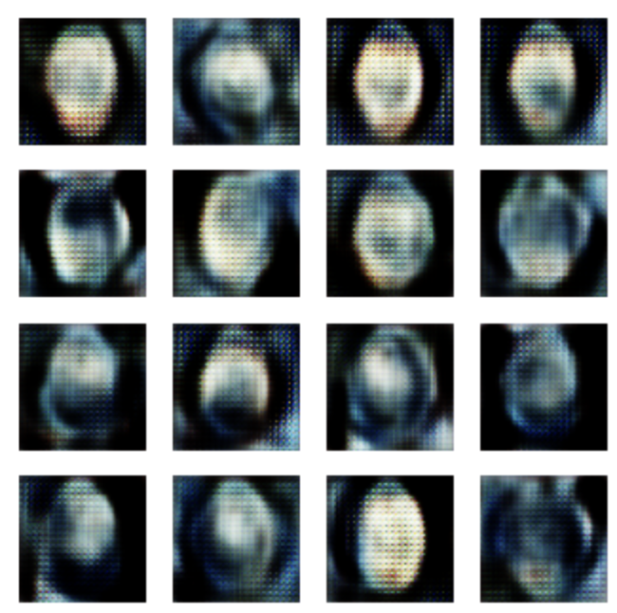
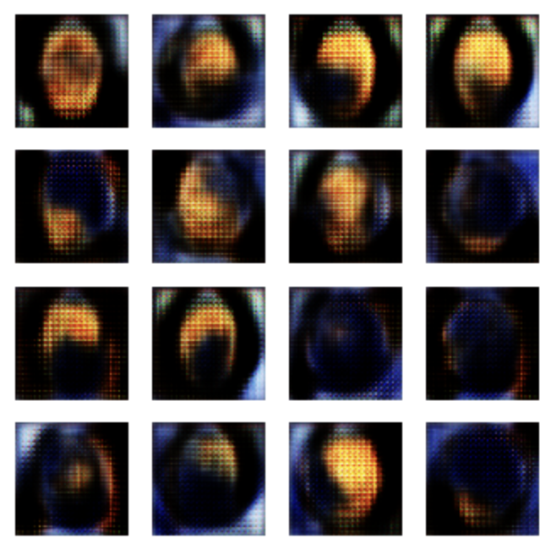
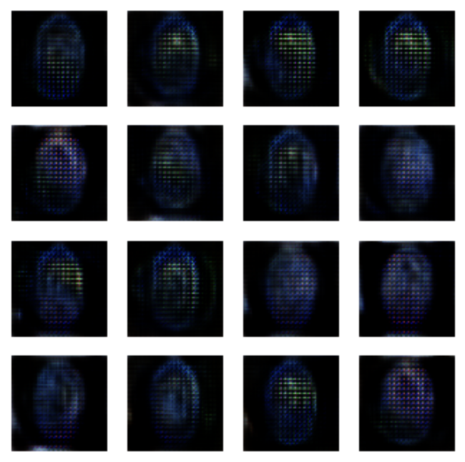
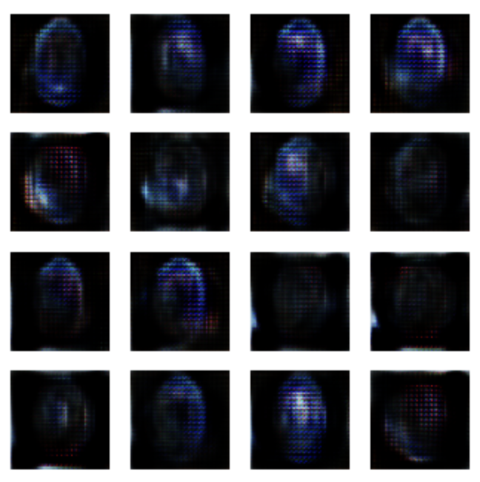
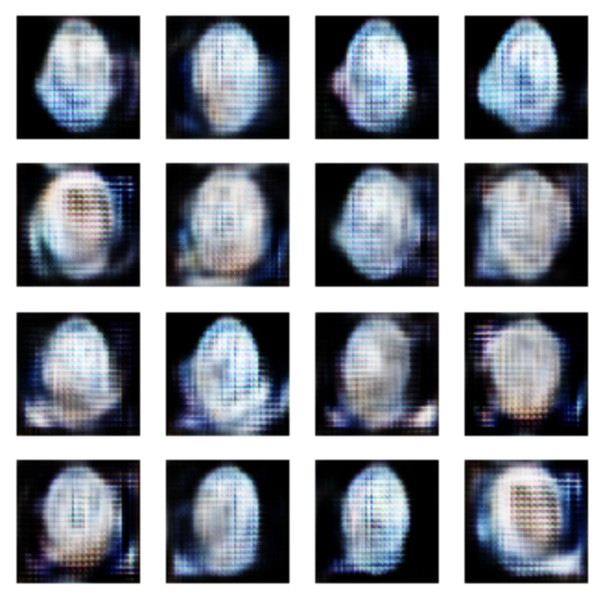
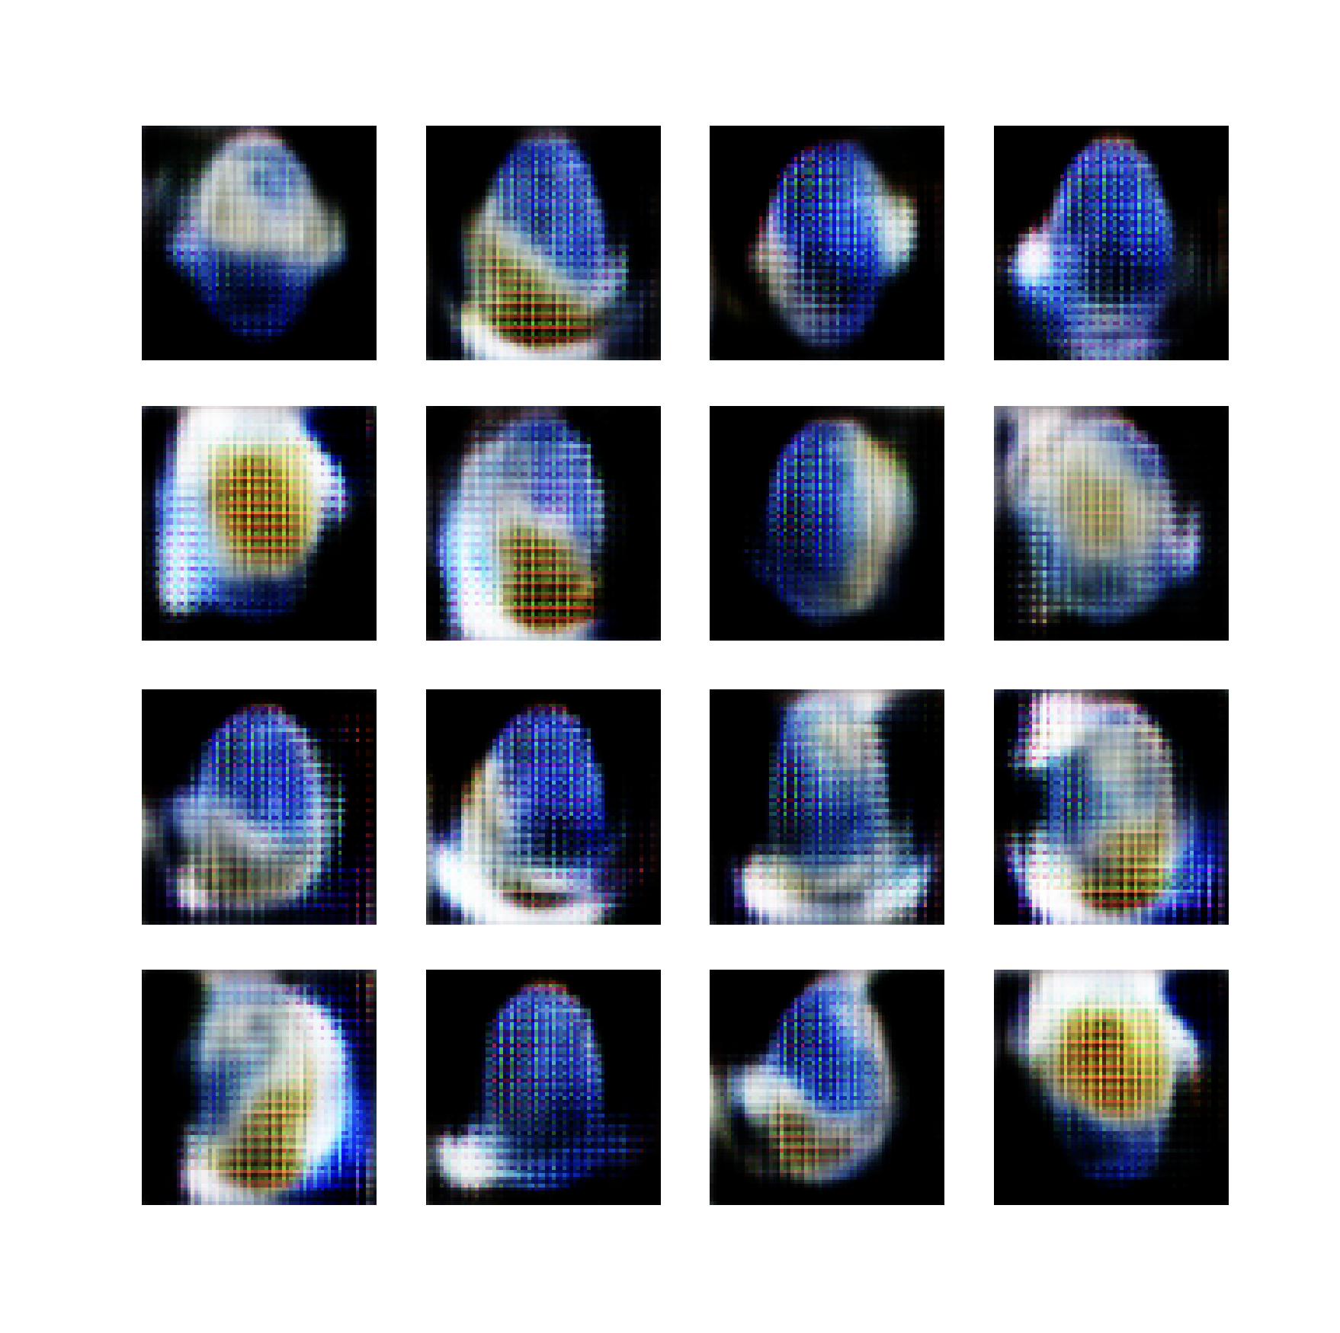
WGANs
09
Generated Planets Images
Epoch 1000
Epoch 2200
Epoch 3100
Epoch 4400
Epoch 5000
Epoch 5800
Epoch 6800
Epoch 9700

Slide 24
Quantum
Machine Learning

Slide 25
Quantum
Computing

Slide 26
QML
Introduction
The goal of generative ML is to model the probability distribution underlying a given data set.
This probability distribution helps to characterize the generation process of the data samples
With the help of quantum resources, the respective generative models also have access to functions that are difficult to evaluate with a classical computer and may,
thus, improve the performance or lead to new insights.
Generative QML refers to algorithms which employ a combination of Classical and Quantum resources to solve generative machine learning tasks.
Quantum Generative Adversarial Networks
Quantum Boltzmann Machines
Compatible with first-generation quantum hardware
Because they can be implemented with (sallow) parameterized quantum circuits

Slide 27
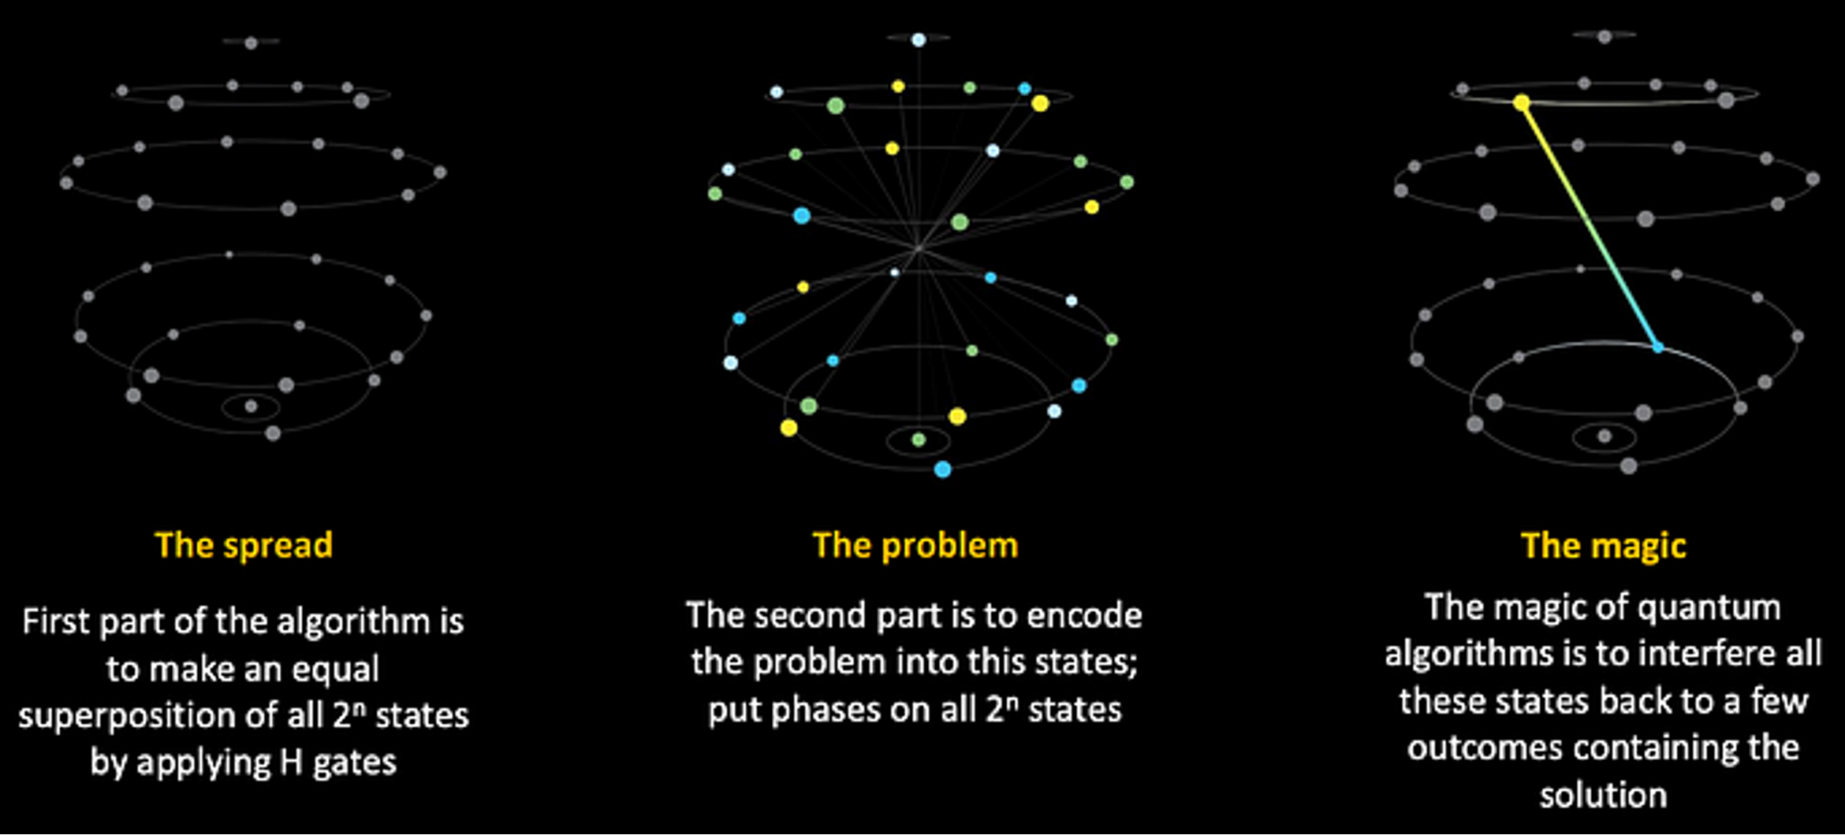
Quantum Computing
10
Introduction
Qubits are the core of quantum computing, they are in superposition until they are measured where collapse into one of two posible states
$$|ψ⟩=α_{0}|0⟩+α_{1}|1⟩$$
When qubits are measured, the capacity is no different from bits.
It’s extremely tricky to design algorithms under this constraint
In a system of $n$ qubits:
$$|ψ⟩=|q_{1}q_{2}q_{3}q_{4}⟩=|1010⟩$$
Quantum computing take advantage of two properties of quantum nature: entanglement and interference.

Slide 28
QML
Quantum Data Encoding
In order to facilitate the realization of QML,
it is important to enable efficient representation of the given training data
This can become a severe bottleneck
Quantum data loading:
Mapping of classical data into a quantum state or quantum channel
$D:X→H$ where $H$ represents a Hilbert space of dimension $2^{n}$
using a type of quantum data encoding (Quantum Feature Maps)
Given Dataset:
$$X=\{x_{0},…,x_{k-1}\}$$
such that:
$$\overset{k-1}{\underset{j=0}{∑}}|x_{j}|^{2}=1$$
Hamiltonian Encoding:
$$E(X)=H(X)=\underset{i}{∑}f_{i}(x)h_{i}$$
where Pauli operators are:
$$h_{i}=⊗_{j=0}^{n-1}σ_{i}^{j}\text{for}σ_{i}^{j}∈\{I,X,Y,Z\}$$
Basis Encoding:
$$E(X)=\frac{1}{\sqrt{k}}\overset{k-1}{\underset{j=0}{∑}}|x_{j}⟩$$
Amplitude Encoding:
$$E(X)=\overset{k-1}{\underset{j=0}{∑}}\sqrt{x_{j}}|j⟩$$

Slide 29
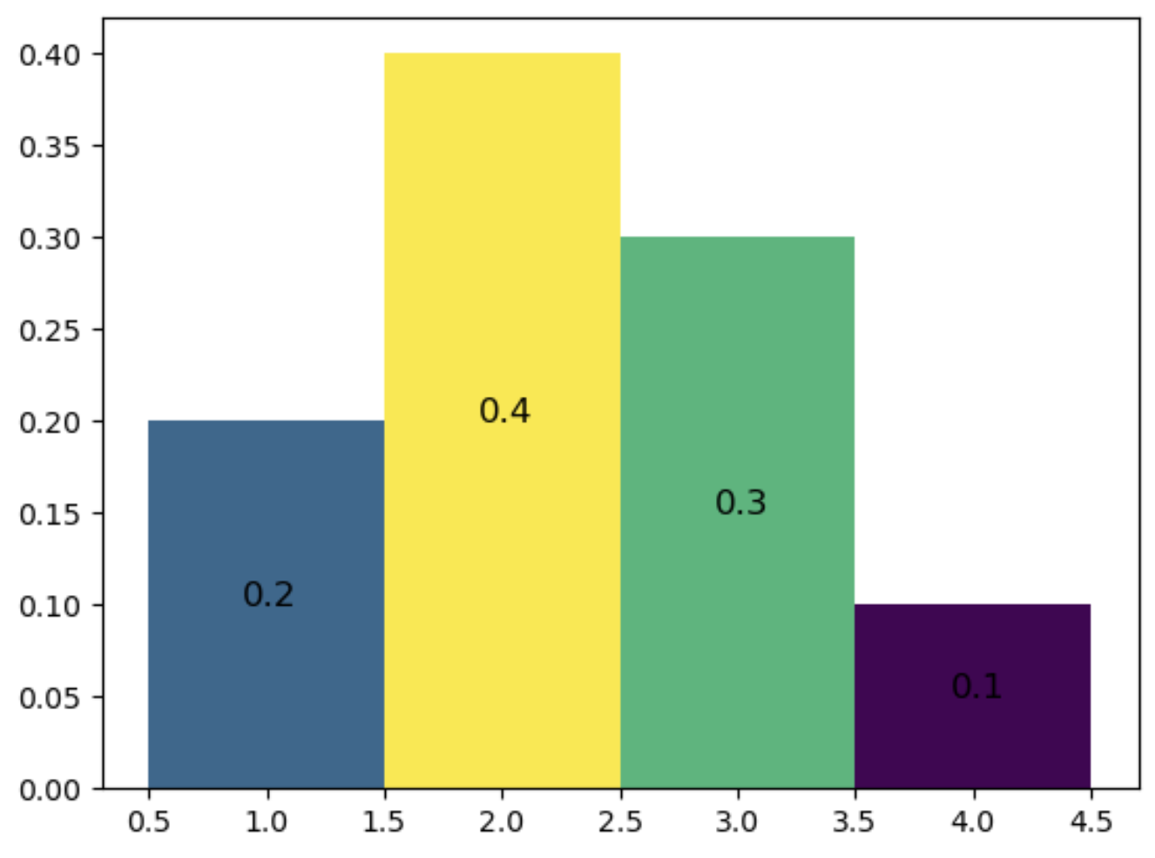
Quantum Machine Learning
11
Variational Quantum Circuits
In order to facilitate the realization of QML,
it is important to enable efficient representation of the given training data
Quantum data loading:
Mapping of classical data into a quantum state or quantum channel
$D:X→H$ where $H$ represents a Hilbert space of dimension $2^{n}$
using a type of quantum data encoding (Quantum Feature Maps)
1D Normalized Discrete Probability distribution
Amplitude Encoding:
$$E(X)=\overset{k-1}{\underset{j=0}{∑}}\sqrt{p_{j}}|j⟩$$
Basis Encoding:
$$E(X)=\frac{1}{\sqrt{k}}\overset{k-1}{\underset{j=0}{∑}}|x_{j}⟩$$
$$x=5=101$$
$$|ψ⟩=|101⟩$$
$$p=\{\begin{matrix}0.2 & \text{si} & x=1 \\ 0.4 & \text{si} & x=2 \\ 0.3 & \text{si} & x=3 \\ 0.1 & \text{si} & x=4\end{matrix}$$
$$|ψ⟩=\sqrt{p_{1}}|1⟩+\sqrt{p_{2}}|2⟩+\sqrt{p_{3}}|3⟩+\sqrt{p_{4}}|4⟩$$
$$|ψ⟩=\sqrt{0.2}|0001⟩+\sqrt{0.4}|0010⟩+\sqrt{0.3}|0100⟩+\sqrt{0.1}|1000⟩$$

Slide 30
QML
Variational Quantum Circuits
Quantum channels are given as variational quantum circuits, representing a parameterized unitary $U(ω)$
Whose respective circuit is composed of $d$ alternating layers of parameterized single qubit gates:
$U_{r}(ω_{r})=⊗_{j=0}^{n-1}U_{r}^{j}(w_{r}^{j})$ acting on the $j^{th}$ qubit.
Increasing $d$ increases the expressivity of the quantum circuit
This circuit prepares a parameterized quantum state as:
$$|ψ(ω)⟩=U(ω)|0⟩^{⊗n}$$
For instance:
$$L(|ψ(ω)⟩)=-\underset{x}{∑}p_{x}(ω)log(p_{x}^{target})$$
Where the cost function can be defined as an expectation value:
$$L(|ψ(ω)⟩)=⟨ψ(ω)|\overset{̂}{O}|ψ(ω)⟩$$
The goal of QML algorithms is to solve the optimization problem:
$$\min_{ω}L(|ψ(ω)⟩$$

Slide 31
Quantum Machine Learning
12
Variational Quantum Circuits
Parameterized quantum state:
$$|ψ(ω)⟩=U(ω)|0⟩^{⊗n}$$
Reach the ground state
Cost function:
$$L(|ψ(ω)⟩)=⟨ψ(ω)|\overset{̂}{O}|ψ(ω)⟩$$
Optimization problem:
$$\min_{ω}L(|ψ(ω)⟩$$

Slide 32
QML
Quantum Gradients
The training of a QML loss function often requires the evaluation of gradients
with respect to the parameters $ω$ of a quantum channel.
First-Order Quantum Gradient:
$$\frac{∂⟨ψ(ω)|\overset{̂}{O}|ψ(ω)⟩}{∂ω_{i}}=2ℜ\left(⟨ψ(ω)|\overset{̂}{O}\frac{∂|ψ(ω)⟩}{∂ω_{i}}\right)$$
Second-Order Quantum Gradient:
$$\frac{∂^{2}⟨ψ(ω)|\overset{̂}{O}|ψ(ω)⟩}{∂ω_{i}∂ω_{j}}=2ℜ\left(\frac{∂⟨ψ(ω)|}{∂ω_{i}}\overset{̂}{O}\frac{∂|ψ(ω)⟩}{∂ω_{j}}+⟨ψ(ω)|\overset{̂}{O}\frac{∂^{2}|ψ(ω)⟩}{∂ω_{i}∂ω_{j}}\right)$$
Quantum Fisher Information Matrix representing the Fubini-Study metric:
$$F_{ij}^{Q}(ω)=ℜ\left(\frac{∂⟨ψ(ω)|}{∂ω_{i}}\frac{∂|ψ(ω)⟩}{∂ω_{j}}-\frac{∂⟨ψ(ω)|}{∂ω_{i}}|ψ(ω)⟩⟨ψ(ω)|\frac{∂|ψ(ω)⟩}{∂ω_{j}}\right)$$

Slide 33
QML
Vanishing Gradients
Quantum state for $n$ qubits:
$$|ψ(ω)⟩=\underset{⏟}{U(ω)}|0⟩^{⊗n}$$
Universal Ansatz
from the Unitary group
Quantum states represented by $n$ qubits live in a $2^{n}$ dimensional Hilbert space $H$
Random unitaries acting on this states can suffer from concentration of measure
Leading to exponentially vanishing gradients (barren plateaus)
Levy’s Lema:
Given a Lipschitz-continuous function $f(|ψ⟩):S^{2n-1}→ℜ$:
$$P(|E(f)-f(|ψ⟩)|≥ϵ)≤2e^{-\frac{nε^{2}}{9π^{2}η^{2}}}$$
To scale up QML algorithms become important to design problem-specific ansätze with only enable to access a limited but suitable subspace of the full Hilbert space

Slide 34
QML
VarQITE
Quantum Time Evolution (QTE) describes the process of evolving a quantum state according to a given Hamiltonian
To implement this in a quantum computer, It needs to ve translated into quantum gates
Time-dependent Schrödinger equation:
$$iℏ|{\overset{·}{ψ}}_{t}^{*}⟩=H|ψ_{t}^{*}⟩$$
Unitary evolution of the state:
$$|ψ_{t}^{*}⟩=e^{-iHt}|ψ_{0}^{*}⟩$$
Wick-rotated Schrödinger equation:
$$|{\overset{·}{ψ}}_{t}^{*}⟩=(E_{t}I-H)|ψ_{t}^{*}⟩$$
Non-Unitary evolution of the state:
$$|ψ_{t}^{*}⟩=\frac{e^{-Ht}|ψ_{0}^{*}⟩}{\sqrt{⟨ψ_{0}^{*}|e^{-2Ht}|ψ_{0}^{*}⟩}}$$
If the parameter $t$ is replaced by an imaginary time
Reach the ground state…
Considering a formulation for pure states based on McLachlan’s variational principle with a global plate-agnostic evolution
Parameterized state:
$$|ψ_{t}^{*}⟩→|ψ_{t}^{v}⟩=e^{-iv}|ψ_{t}^{ω}⟩$$
Wick-rotated Schrödinger equation:
$$|{\overset{·}{ψ}}_{t}^{v}⟩=(E_{t}^{ω}-H+i\overset{·}{v})e^{-iv}|ψ_{t}^{ω}⟩$$

Slide 35
Quantum Generative Adversarial Networks

Slide 36
Generative QML
Introduction
The goal of Generative QML is to learn the random distribution underlying given training data by using sampling statistics of a parameterized quantum state
First approach:
Training the (initialized) parameters of a variational quantum circuit based on the measurements samples and the respective loss function
$$↓$$
Quantum Generative Adversarial Networks
Second approach:
Training the (initialized) parameters of a quantum operator (Hamiltonian) based on the measurement statistics of the mapped quantum state
$$↓$$
Quantum Boltzmann Machines
Generative QML facilitates implicit learning of the data generation process
(Suitable for execution on near-term quantum hardware)
Standard schemes may require to model an explicit distribution
(Requires expensive quantum algorithm)

Slide 37
Quantum GANs
13
Introduction
Quantum GANs employ an interplay of a generator and a discriminator to learn
an implicit approximate representation of a probability distribution
underling given data samples into a variational quantum circuits
Quantum generator generates quantum states
$$↓$$
Variational Quantum Circuit
Quantum
Quantum discriminator measures quantum states
$$↓$$
Classical Neural Network
Quantum
Quantum state
The generator goal is to minimize the distance between the generated and target quantum states
The discriminator goal is to discriminate correctly between these states

Slide 38
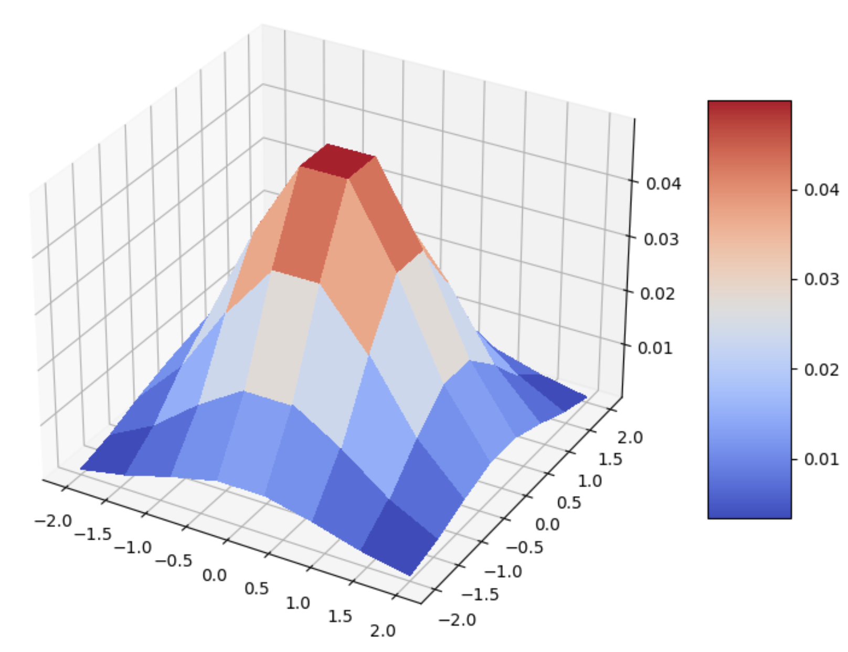
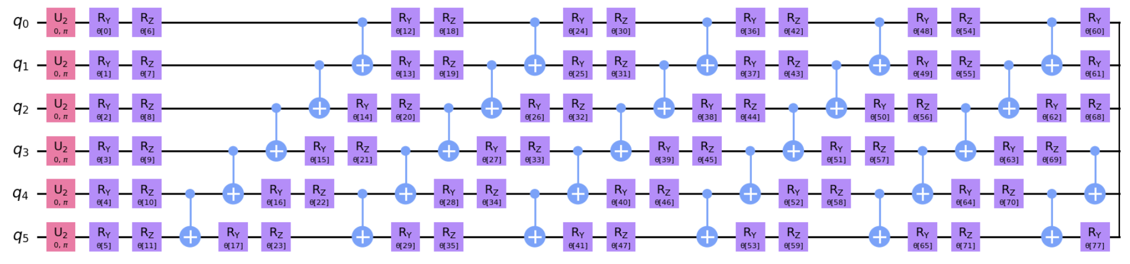
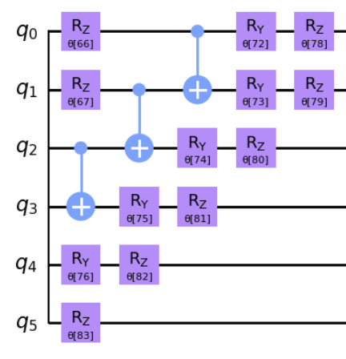
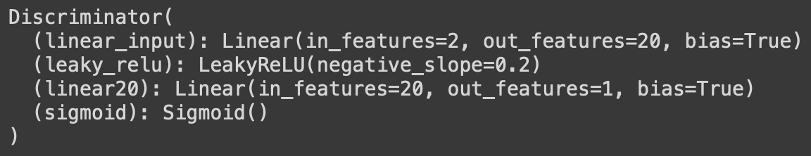
Quantum GANs
14
Statistical Example Arquitecture
Discrete Bivariate Normal Distribution
Cumulative Density Function
Generator and Discriminator Loss Function
Generator as a Quantum Neural Network
Discriminator as a Classical Neural Network

Slide 39
Generative QML
Training the QGAN
The quantum generator (variational quantum circuit or quantum Boltzmann machine) is trained to transform a $n$-qubit input state $|ψ_{in}⟩$ to a $n$-qubit output state ($2^{n}$: resolution)
$$G^{ω}\underset{⏟}{|ψ_{in}⟩}=|g^{ω}⟩=\overset{2^{n}-1}{\underset{b=0}{∑}}\sqrt{p_{b}(ω)}|b⟩$$
Carefully chosen
Given $m$ data samples $g_{j}$ from the quantum generator sampled with probability $p_{j}(ω)$ and $m$ randomly chosen training data samples $x_{j}$
Generator loss:
$$L_{G}(ϕ,ω)=-\overset{m}{\underset{j=1}{∑}}p_{j}(ω)log(D^{ϕ}(g_{j}))$$
Discriminator loss:
$$L_{D}(ϕ,ω)=\frac{1}{m}\overset{m}{\underset{j=1}{∑}}log(D^{ϕ}(x_{j}))+p_{j}(ω)log(1-D^{ϕ}(g_{j}))$$
$$L_{G}$$
$$D^{ϕ}$$
$$g_{j}$$
$$L_{D}$$
$$D^{ϕ}$$
$$D^{ϕ}$$
$$g_{j}$$

Slide 40
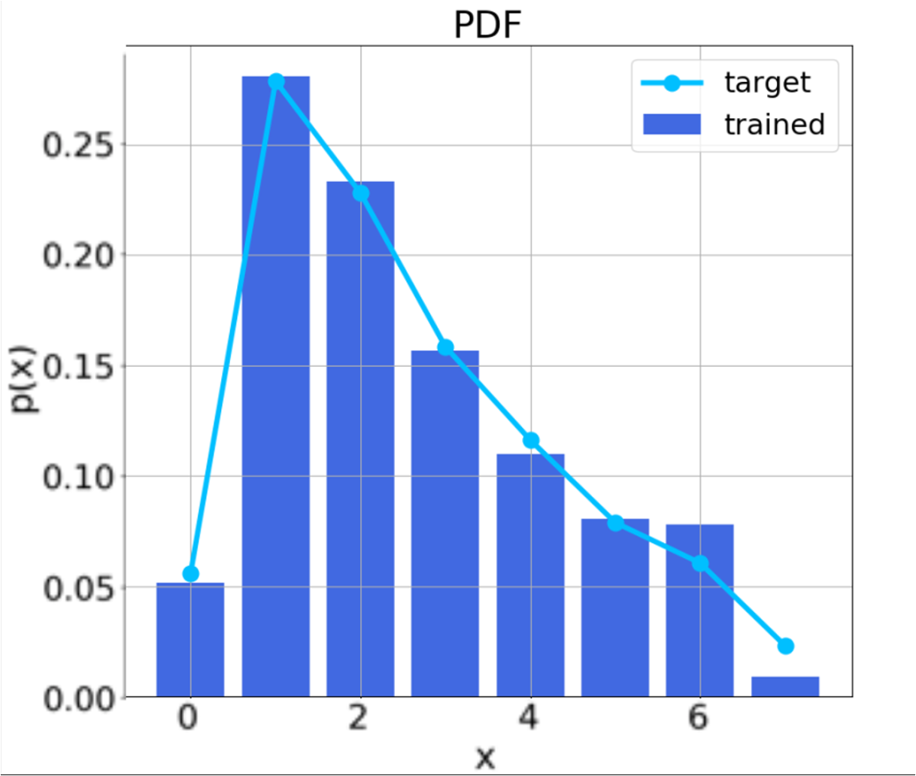
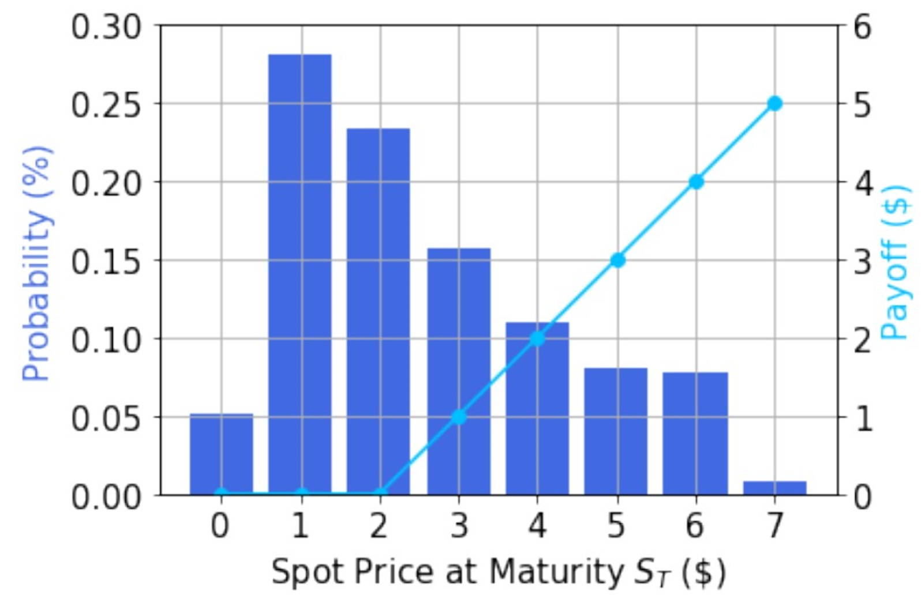
Quantum GANs
15
Quantum Finance Example
Example of application of a hybrid qGAN in the loading of a log-normal distribution associated with the price of an European call option
The use of this method allows the potential of quantum computing to be exploited without being affected by the large number of quantum gates
used in the loading of a distribution in a variational circuit

Slide 41
Thanks for your attention

Slide 42
References
Papers and websites with code implementations
Ian J. Goodfellow, et al. (2014). Generative Adversarial Nets.
TensorFlow. Deep Convolutional Generative Adversarial Network. Retrieved from: https://www.tensorflow.org/tutorials/generative/dcgan?hl=es-419
Generative Adversarial Networks implementation. Retrieved from: https://nn.labml.ai/gan/original/index.html
Martin Arjovsky, et al. (2017). Wasserstein GAN.
Ishaan Gulrajani, et al. (2017). Improved Training of Wasserstein GANs.
Nanny ML. Wasserstein Distance Explained. Retrieved from: https://www.youtube.com/watch?v=9rqmkDsUK2g&t=118s
WGAN: Wasserstein Generative Adversarial Networks. Retrieved from: https://blog.paperspace.com/wgans/
WGANs: Explained. Retrieved from: https://medium.com/@mladenkorunoski/wgans-explained-fab61bda2576
Wasserstein GAN: TensorFlow Implementation using MNIST. Retrieved from: https://github.com/Mohammad-Rahmdel/WassersteinGAN-Tensorflow
QC — What are Qubits in Quantum computing? Retrieved from: https://jonathan-hui.medium.com/qc-what-are-qubits-in-quantum-computing-cdb3cb566595
QC — Programming with Quantum Gates (Single Qubits) Retrieved from: https://jonathan-hui.medium.com/qc-programming-with-quantum-gates-8996b667d256
Christa Zoufal. (2021). Generative Quantum Machine Learning.
Christa Zoufal, et al. (2019). Quantum Generative Adversarial Networks for Learning and Loading Random Distributions.
Qiskit. PyTorch qGAN implementation. Retrieved from: https://qiskit.org/ecosystem/machine-learning/tutorials/04_torch_qgan.html

